Slide 1


News Summarization
Extract Summarization
Team Member
Youngjun Ju(주영준)
Kiwon Seo(서기원)

Slide 2




INDEX
NEWS SUMMARIZATION
DATA
MODEL DESCRIPTION
EVALUATE METRICS

Slide 3

“
- News Summarization
- Extraction
01
NEWS
SUMMARIZATION

Slide 4
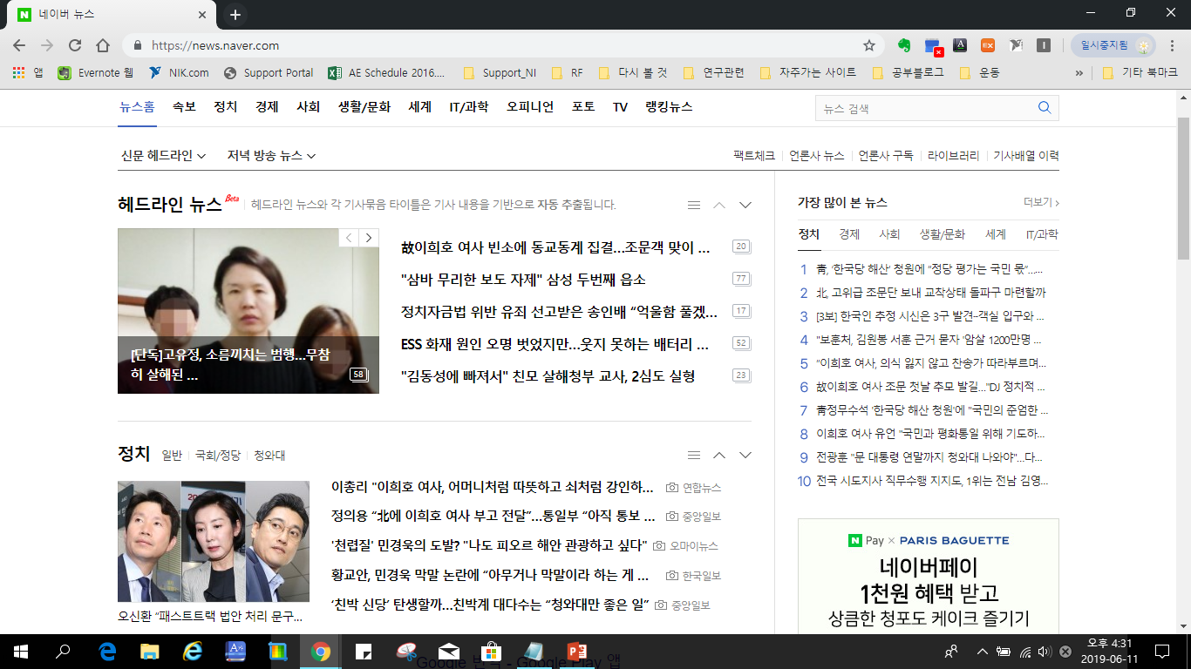
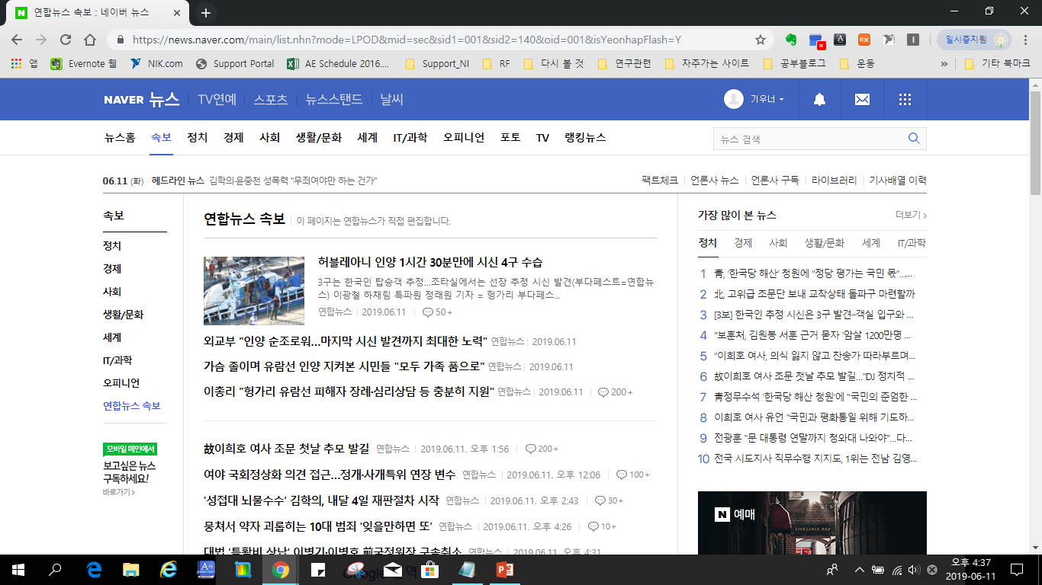
News Summarization
A lot of articles are made every day

Slide 5
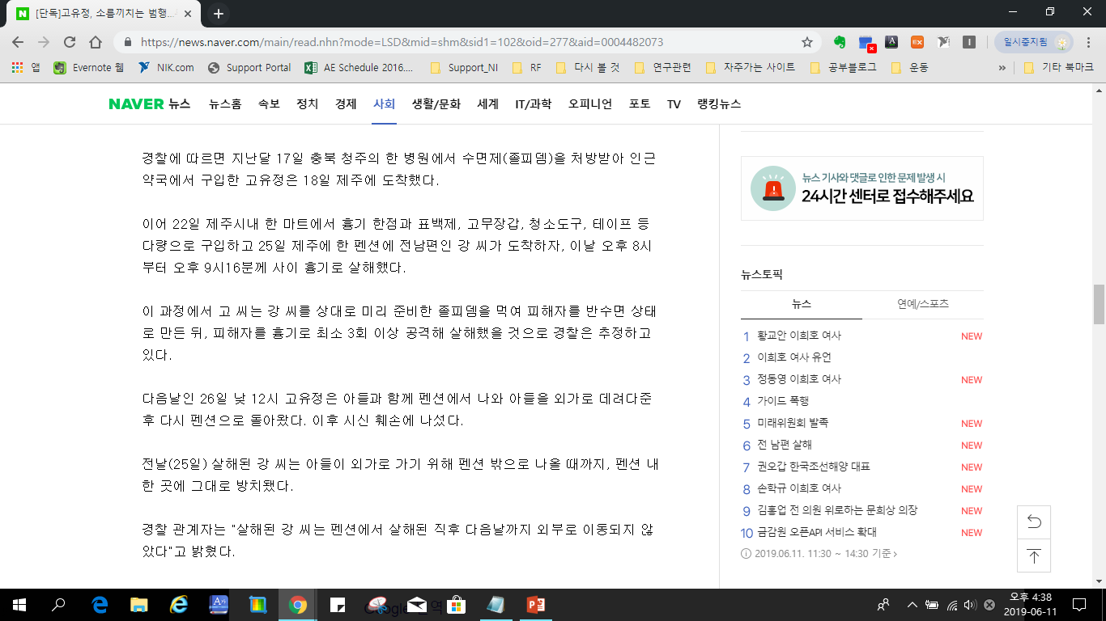
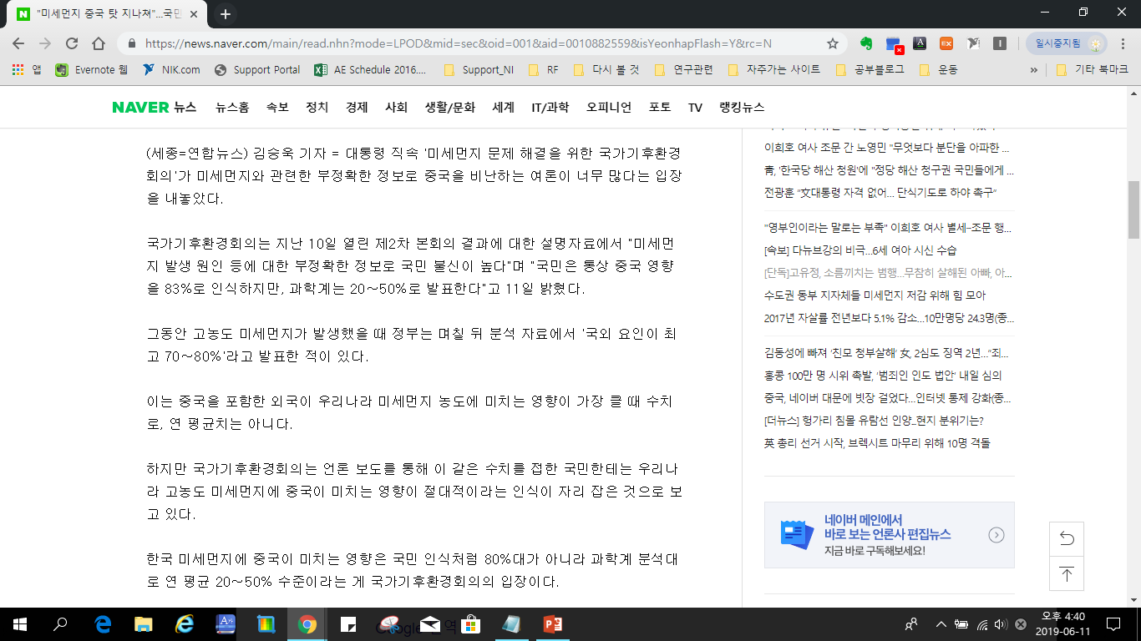
News Summarization
There are too many articles to read

Slide 6
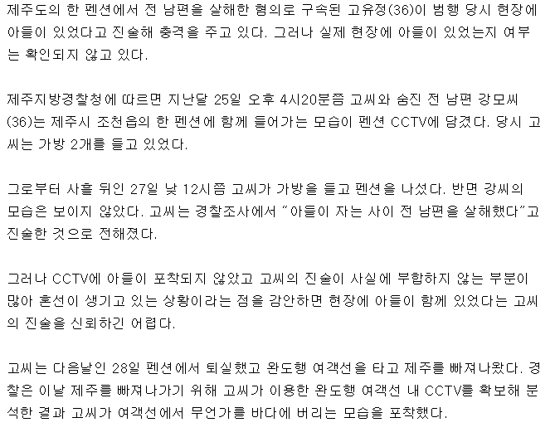
News Summarization
IDEA
Develop a model to summarize the articles
'고씨는 경찰조사에서 “아들이 자는 사이 전 남편을 살해했다”고 진술한 것으로 전해졌다. 경찰은 또 고씨가 강씨의 시신을 해상에 이어 육지에도 유기했을 것으로 보고 수사를 확대하고 있다. 고씨는 전 남편 강씨의 휴대전화를 통해 자신에게 문자를 보내는 등 범행을 은폐 시도를 한 것으로 알려졌다.

Slide 7
News Summarization
Extraction
Abstraction
Text Summarization
The extract summary selects sentences that considered important.
The abstraction summary creates a summary by creating a new vocabulary.
We choose extract summary to summarize news articles!

Slide 8
“
Data
Crawling
02
DATA

Slide 9
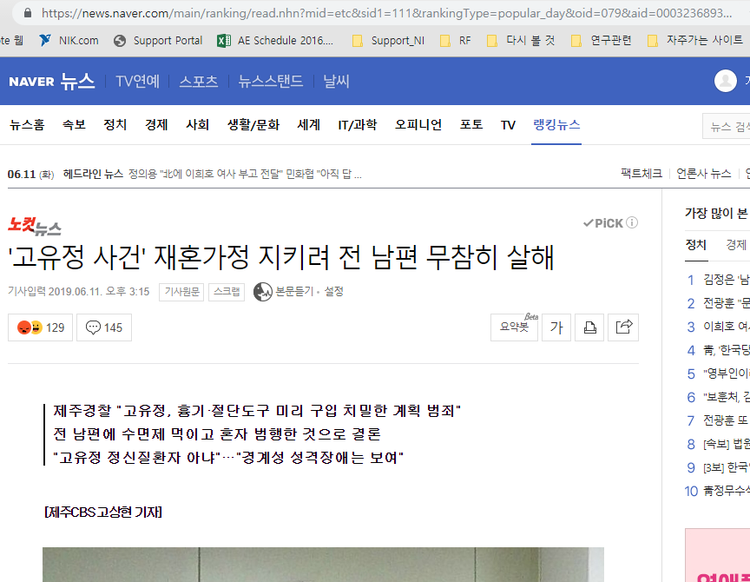
Data
URL
Title
Main Text

Slide 10
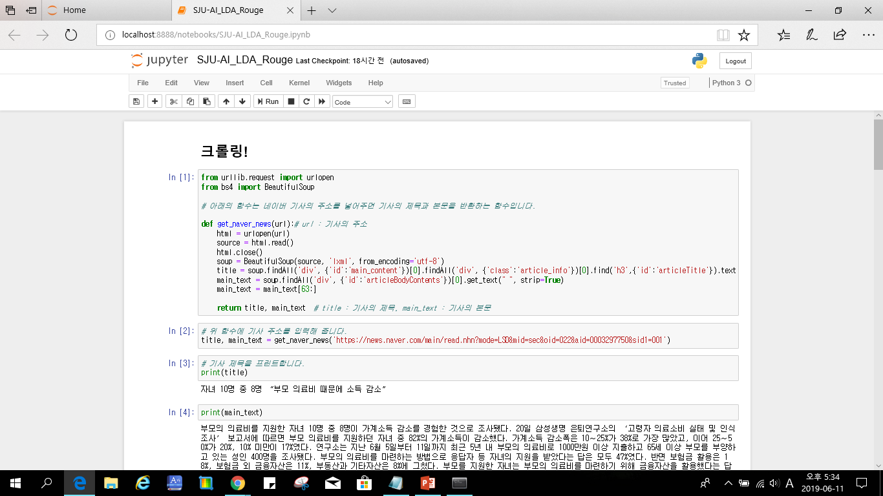
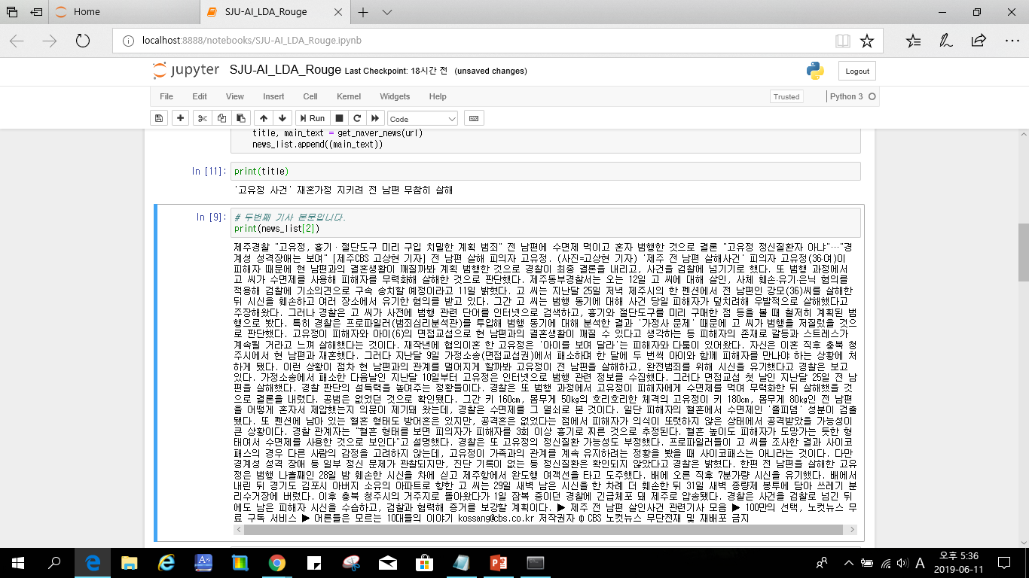
Data
CRAWLING
COLLECTED DATA
TRAINING DATA
TEST DATA

Slide 11
“
- Tokenize
TF-IDF
LDA / LSI / HDP
Textrank
03
MODEL
DESCRIPTION

Slide 12
Model Description
Input Text
Tokenize
Pos Tag
TF-IDF
Topic Modeling
TextRank
Output
System configuration diagram

Slide 13
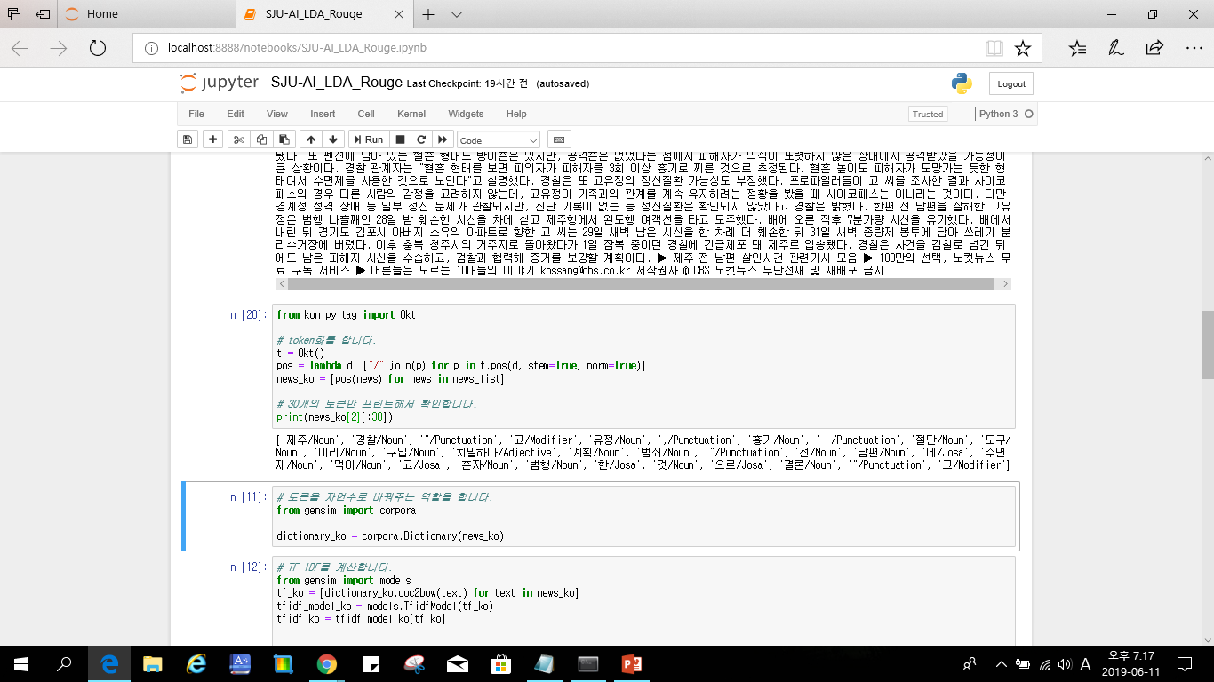
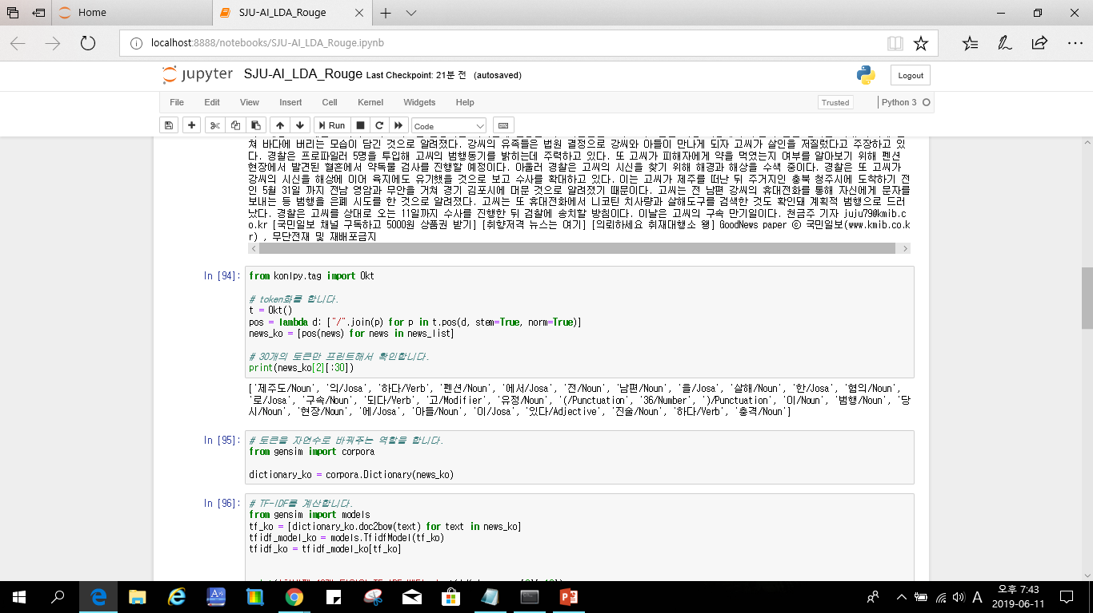
Model Description
Tokenization
제주도, 펜션, 전, 남편, 살해, 혐의 , 고, 유정, 범행, 현장, 아들, 진술

Slide 14
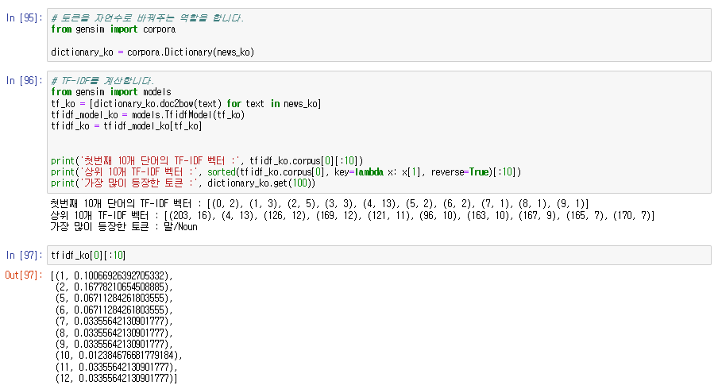
Model Description
TF-IDF : Term Frequency - Inverse Document Frequency
Vectorization!

Slide 15
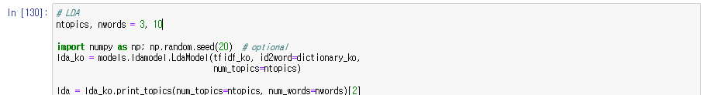
Model Description
LDA : Topic Modeling
An algorithm that finds topics through words that appear frequently in a document

Slide 16
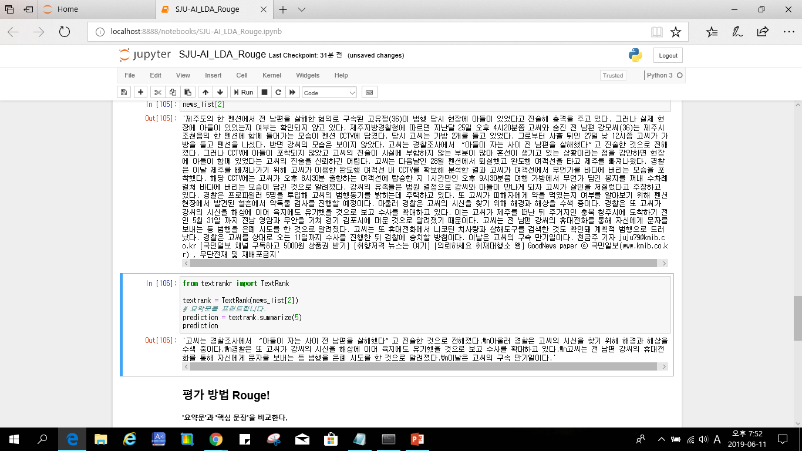
Model Description
Textrank
- Textrank algorithm is a good core sentence extraction algorithm.
- TextRank uses a pagerank algorithm known as the algorithm that makes Google.

Slide 17
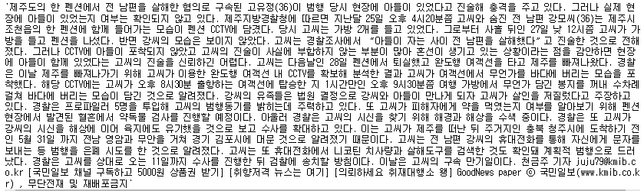
Model Description
Result
“아들이 자는 사이 남편 살해했다” 고유정 진술에 ‘충격’

Slide 18
“
- Rouge
04
EVALUATE
METRICS

Slide 19
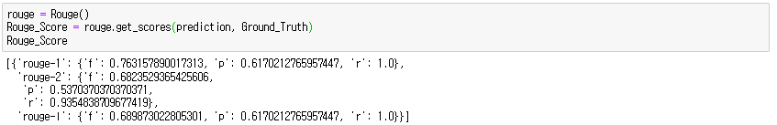
Evaluate Metrics
Rouge
- ROUGE is a performance metric often used in document summaries
- ROGUE uses n-gram recall between reference summaries and system summaries as a performance measure
- TextRank uses ROUGE-1 because it usually performs unigram extraction.
Average
Language | Rouge Score
Korean | 0.68
English | 0.47
Brazilian | 0.49
Our Result

Slide 20

News Summarization
Team Project
THANK YOU

